Slide 1
PowerShell Scripting for Automation
Nolan Pestano, Intelligent Automation Co-op
Unlocking Potential By Driving Innovation Forward

Slide 2

Agenda
Introduction
Context/Problem
My Solution
More On Batch Scripts
Lessons Learned
Questions

Slide 3




About Nolan
Hi! I’m Nolan Pestano
I am an Intelligent Automation Co-op
University of Missouri Student of Computer Science, go tigers!
Backgrounds include:
Software developing World of Warcraft Hacks
Infrequently paid Standup Comedian based in Kansas City
Cook at Glenn's Café, in Columbia, MO

Slide 4
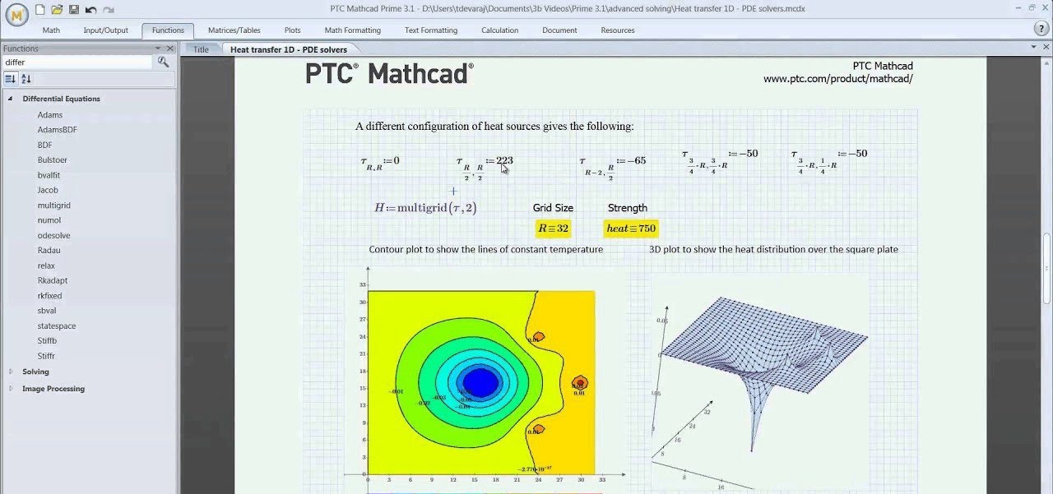
Context
Mathcad is an engineering calculation tool that lets one solve, document, and share math using natural mathematical notation.
This is (generally) used by Mechanical Engineers in Emerson.

Slide 5
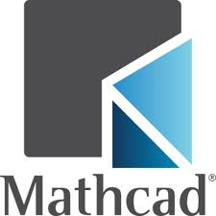

Problem statement
The issue was with all the Mathcad files (.mcdx), there was not an easy way to convert them all to PDFs.
The feature in Mathcad itself for conversion was very messy and not intuitive.

Slide 6

Problem statement
Limited Mathcad automation options
No clean Python or workflow
Documentation assumed manual steps
However,
Familiar feeling from past automation work
Idea in mind of how to automate
Needed something future‑proof, and felxible

Slide 7
The Key question
What’s the simplest reliable solution?
What already exists on every machine?
What requires the least context to understand later?

Slide 8

ANSWER: Use Powershell scripting!
Native to Windows
No dependencies
Clear, linear flow

Slide 9

Powershell Crash Course
PowerShell scripting is a windows native language that executes command line interfaces sequentially, the successor to batch files.
PowerShell is great at repeated, logical operations, and file/folder interaction.
A fantastic choice for automating Windows and file automation

Slide 10
Solution Goals
Write a PowerShell‑based automation to convert all Mathcad files to PDFs
One command, scalable, and portable solution
Least interaction as its for a non-tech team

Slide 11
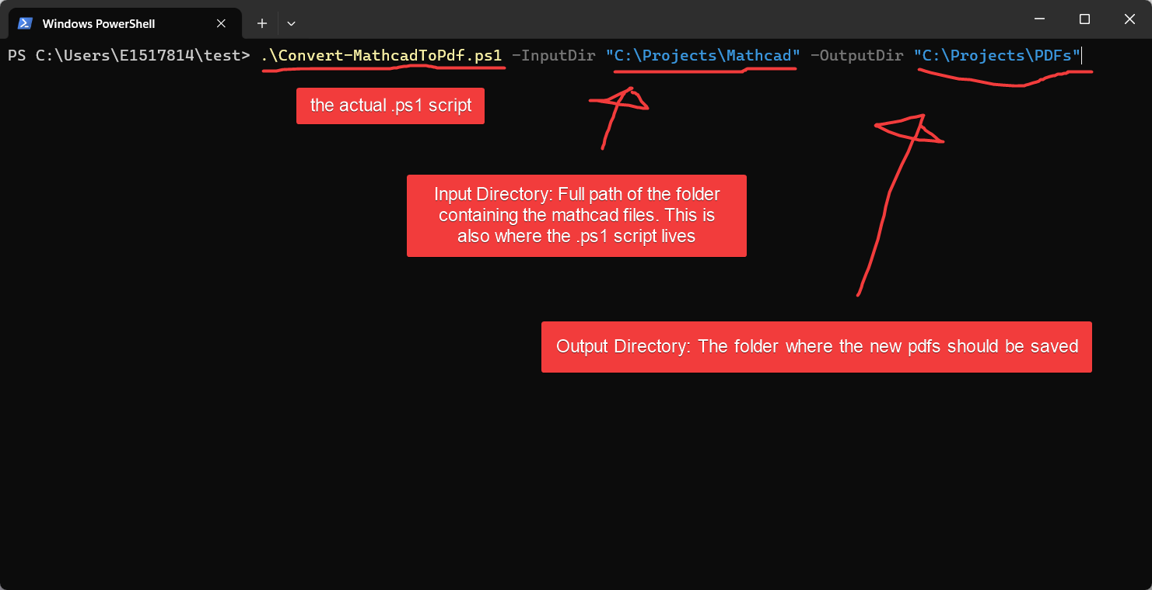
Solution - Inputs & Setup

Slide 12
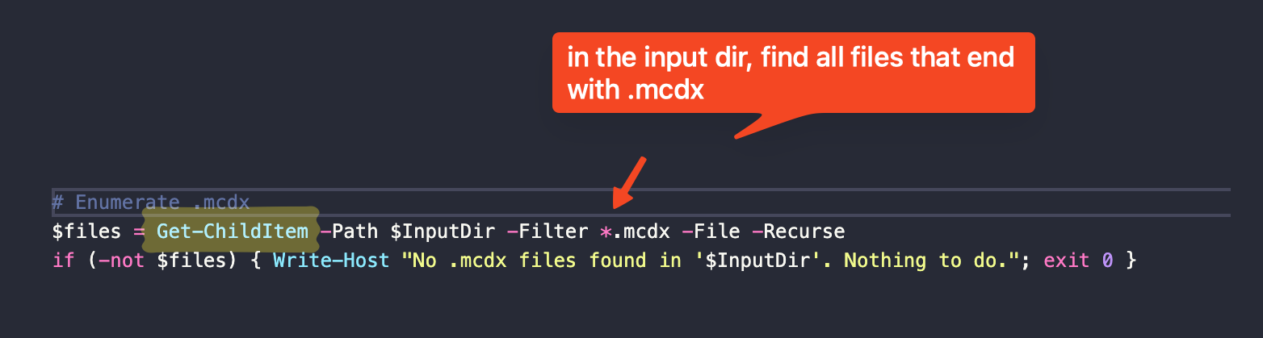
Solution – Parse for mathdocs
Recursively scans input directory
Filters only .mcdx files
Works on large folder trees
Zero manual file selection

Slide 13
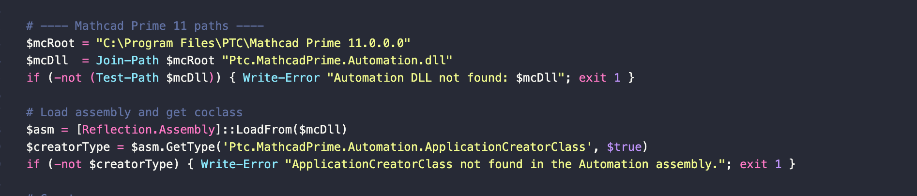
Solution – Parse for mathdocs
Loads Mathcad Prime Automation DLL
Uses existing COM interface
No UI interaction required
Same method Mathcad uses internally

Slide 14
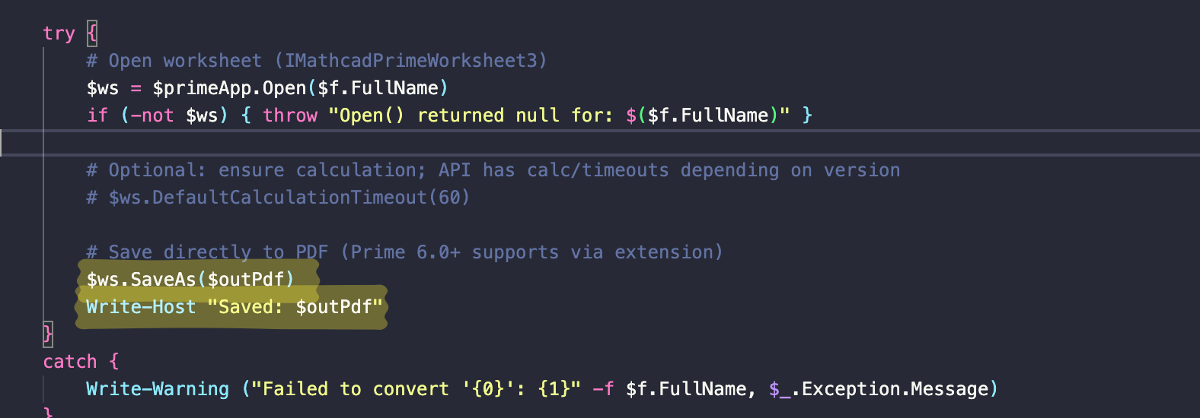
Solution: Convert to PDF
Open each worksheet programmatically
Save directly as PDF
Close worksheet safely
Continue even if one file fails

Slide 15
Lessons to learn

Slide 16
Portability beats Cleverness
“If all you have is a hammer, everything looks like a nail”
As developers, it is staggering to realize how many tools we have at our disposal! We can’t get too in touch with one stack.
When writing a solution for other people, consider who will be using it, and what the ultimate goal is.

Slide 17
Flexibility Comes from Simplicity
It’s tempting to solve every edge case up front, but that often makes systems brittle instead of robust.
By keeping logic simple and linear, the solution becomes easier to understand, easier to trust, and easier to change.
When requirements shift, and they always do, flexibility means the code bends instead of breaking.

Slide 18
Speed Isn’t Just Runtime, It’s Human Time
Automation should remove friction, not just milliseconds. Every manual step replaced is one less decision, one less mistake, and one less interruption in someone’s day.
The fastest solutions are the ones people actually use, because they make work feel effortless.

Slide 19
Questions?

Slide 20
Thank you!
Nolan Pestano, Intelligent Automation Co-Op

